Slide 1
Subject & Protocol Registries
C3PR F2F Meeting
March 25, 2010

Slide 2
What is CTMS at Mayo Clinic?
A multi-phase, multi-year development of a Clinical Trials Management System to facilitate enterprise wide comprehensive and efficient planning, implementation, management, monitoring, and reporting of protocols and trials for Mayo Clinical Research.

Slide 3
Concept Development
Analyze Study
Translation
Protocol & Subject
Abstraction/Registry
Protocol
Development
Site
&
Staff
Manager
Plan Study
Bibliography
(REAIMS)
Analysis
&
Reporting
Protocol
Authoring & Management
Report &
Time Tracker
Finance
&
Billing
(MIRIS)
Tracking
Messenger
Events Manager
Workflow
Portal
Interfaces
Subject Monitoring
Infrastructure
IRBe
Report Manager
Security
Study Manager
Search Engine
Regulatory
Manager
Protocol Review
Color Key:
Electronic Data Capture and Management
Registration and Randomization
Ring:
Patient Study Calendar
caBIG BAM
Conduct Study
Agent Setup & Inventory
Mayo Protocol Lifecycle
Protocol Execution
CTMS Functionality
Infrastructure
Initiate Study

Slide 4
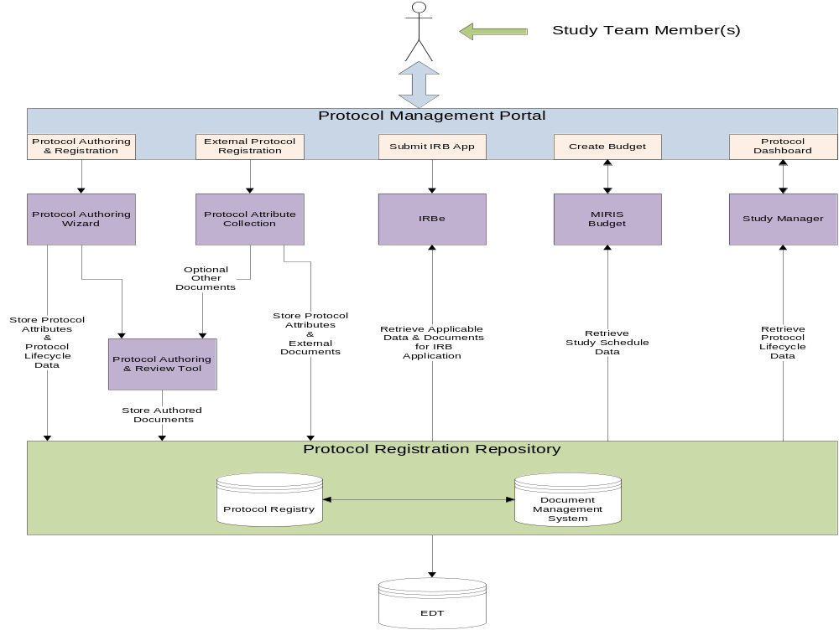

Slide 5
Registry Project Background
Protocol Authoring pushed out beyond CTMS Phase II
  Reviewed protocol authoring products lack essential functionality and maturity in the academic research marketplace
  NCIs CTEP organization currently undertaking a protocol authoring procurement process similar to that just completed for EDC
Why is base registry infrastructure required?
  Centralized and secure information
  Support future research systems integrations
  Support regulatory reporting
  Support research enterprise reporting requirements

Slide 6
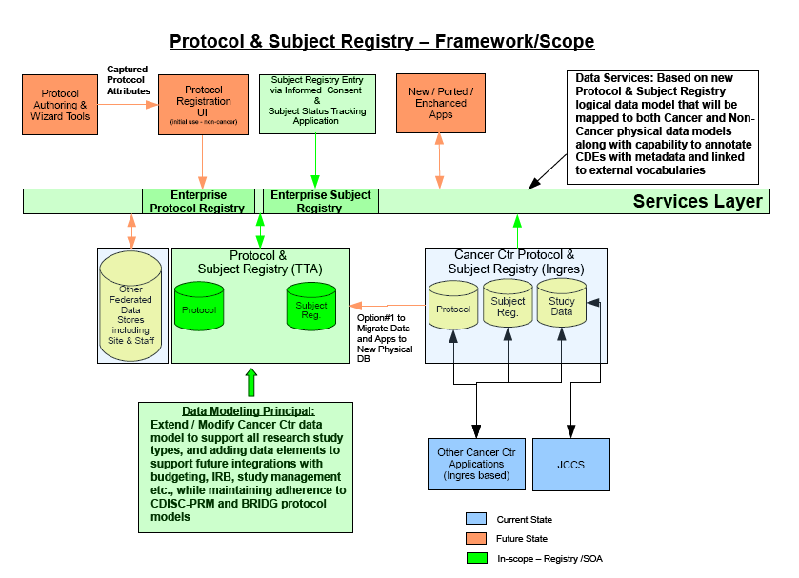

Slide 7
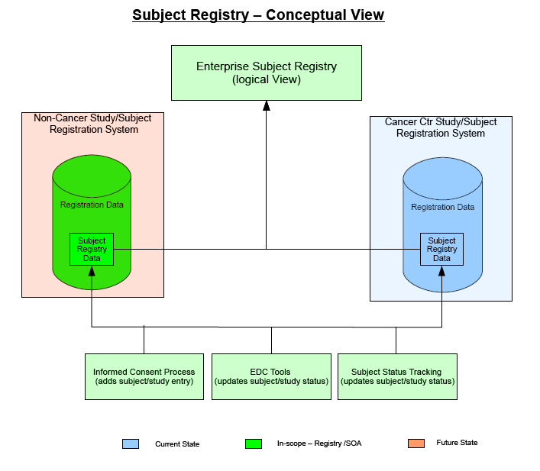

Slide 8
What Subjects?
All Mayo site study subjects (both with and without Mayo Clinic Numbers) who have been consented using the approved Mayo IRB informed consent process for either written or verbal consents
As an example the above definition excludes the following types of study subjects:
  All retrospective chart review study subjects – using Minnesota authorization process of consent
  All Non-Mayo site study subjects not consented with Mayo IRB approved consenting process

Slide 9
Subject Registry Contents
IRB Number
Base demographic information for each subject (both current and study snapshot)
Current and historical tracking of subject status throughout the subject/study lifecycle
Information from informed consent document
  Data & bio-specimens permissions
  Date of consent
  Consent document version
Set of volunteer/subject identifiers
  System ID:
    System generated unique id for each individual
    Never externalized
  Mayo MMC:
    Mayo Clinic patient number, not required
  Subject ID:
    Study assigned, study specific, not required

Slide 10
RESEARCH
PRACTICE
Mayo Research Subject Registry
Services Layer
Annual Rpts
FDA Rpts
NIH Rpts
AD-Hoc Rpts
Subject-Study Registry Rpts
Instant flagging of patient as a research participant
Research tab
  IRB#
  Protocol title
  GTMR indicator
  IRB status
  Consent date
  Participant status
  IND/IDE info
  Link to protocol info
Subject Demographics
Subject–Study Status
Consent Info
MICS
EMR
Extract subject info for IRB continuing review
Consent form version control
Re-consent processing
IRBe
Import subject demographics
Export subject status info to MRSR
EDC Tools
MSS
Mayo Scheduling System
Verification of patient consent status
Verification of IRB status
Import study-subject data for research billing
MIRIS
Others
Extract biospecimen consent info for biospecimen management
RLIMS
Others

Slide 11
Subject Registry Population via IC
Step #1 Prepare IC Document
Enter:
Protocol ID &
MMC# or
Demographics
IRBe
Retrieve current
version of IC
Prepare subject specific informed consent document
Bar-coded subject specific IC document
Retrieve subject’s current demographics
Mayo
Patient
Registry
Temp storage for subject and IC info
Step #2 Record Executed IC Document
Enter:
Informed Consent
ID#
Subject Registry
Record Informed consent execution in the subject registry
EMR
Flag as research participant
Study subjects imported into EDC Tool
Executed IC document is scanned into the EMR

Slide 12
Study / Subject Lifecycle
Study/Subject Timeline
Process
Informed
Consent
Active
Intervention
Phase
Pre-Consent
Screening
Post-Consent
Screening
Registration &
Randomized
Complete
Contacted
Long Term
Follow-up
Recruited
Enrolled
Accrued
Completed
Screen
Failure
(rc)
Active
Intervention
Long Term
Follow-up
Observation
Withdrawn
(rc)
Deceased
Subject Status Transitions

Slide 13
Business Value – Subject Registry
Promote patient safety
  Ability to flag the EMR to indicate patient is participating in active study
  Provide a research tab with research related information (protocol information, consent forms, charted research procedures and date/time, etc.)
  Inform study teams when subject is on multiple studies so potential intervention conflicts can be addressed or avoided
Centralized and secured subject registry
  Facilitate secured, real-time access to research subject consent status by both practice and research patient care staff
  Reduce/Eliminate the need for each study team to build their own registries

Slide 14
Business Value – Subject Registry
Enforce process compliance
  Eliminate risk of administering research procedure to un-consented subject
Reduction in data entry effort
  Ability to capture subject demographics from the Mayo Registration
  Ability to push subject information to EDC tools (Rave / REDCap / SASDMS) and study registration systems
Enable research enterprise wide business intelligence and ad-hoc reporting of subject/study information
  Ability analyze / access cross study information
Efficient management of re-consent process
  Record consent form version and consent date

Slide 15
Business Value – Subject Registry
Enable efficient data/bio-specimen management processes
  Data/bio-specimen permissions from consent form recorded in subject registry
Research finance – industry billing, grant accounting, etc
  Feed registered subjects to MRIS (this will enable MRIS to go to Lawson for financial activity)
Compliance/Regulatory management
  Minority Inclusion Reporting
  FDA Reporting
  IRB Continuing Review
  NIH Reporting

Slide 16
Business Value – Subject Registry
Policy compliance monitoring - enforcing subject registration rules
  Disable subject consenting if study not IRB Approved
  Disable subject consenting if study halted by IRB
  Disable subject consenting if study not funded or lost funding
Recruiting Aid
Measure screen failure rates (signed consent vs. Accrued)

Slide 17
Subject Registry Project Status
Subject registry deployment scheduled Q1/2011
In-progress project activities
  System architecture planning
  Data modeling
  Business requirements gathering

Slide 18
C3PR Adoption Challenges/Opportunities
Enterprise Wide Registries
  Interoperable with legacy cancer center database and application architecture
  Build/buy/adopt new data model and application set for non-cancer registration/registry
  Single logical view of Cancer and Non-cancer
C3PR Tightly Coupled Application and System Architecture
  UI de-coupled from services layer
  Functional de-coupling
    Example: Protocol - Subject - Site
Integration with future / legacy system
  Requirement to integrate with future / legacy systems through ESB and/or Data Services architecture
  Ability to plug and play with components that are not fully defined

Slide 19
Next Analysis Steps
Data Model Alignment
  Informed Consent document identifier
  Epoch/Subject Status/Arm
  Date of death
Services Alignment
  Understanding planned Service Oriented Architecture
  Design point to support federated or legacy data stores
  Component level approach to adoption
C3PR Product Timelines/Roadmap

